Slide 1
Nutrients
October 15, 2019

Slide 2
Biologically essential nutrients

Slide 3
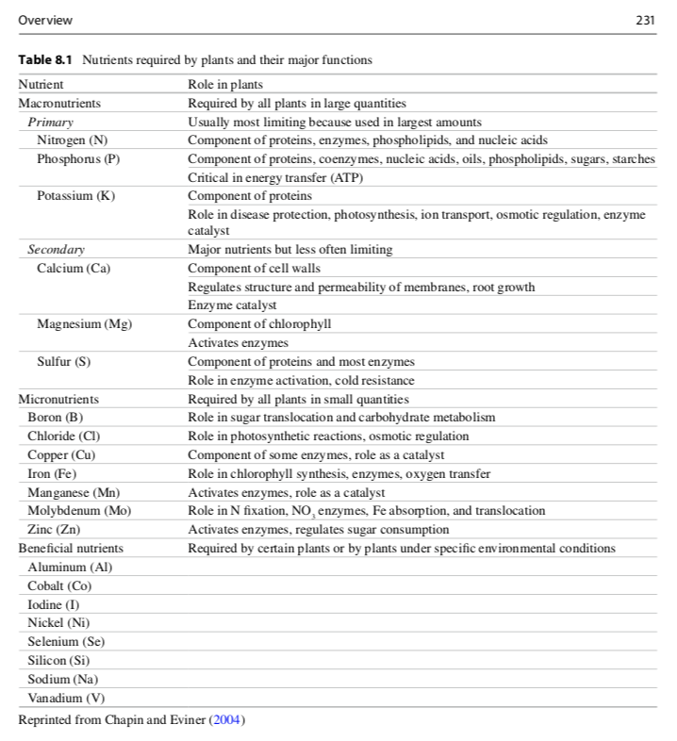

Slide 4
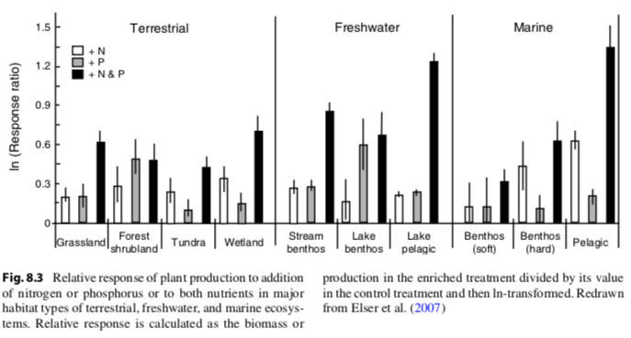
Nutrients limit productivity (primarily N and P)

Slide 5
Nutrient cycling

Slide 6
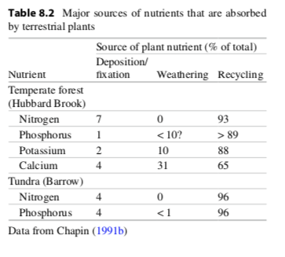
Nutrients cycle through ecosystems differently

Slide 7
Nutrients cycle through ecosystems differently

Slide 8
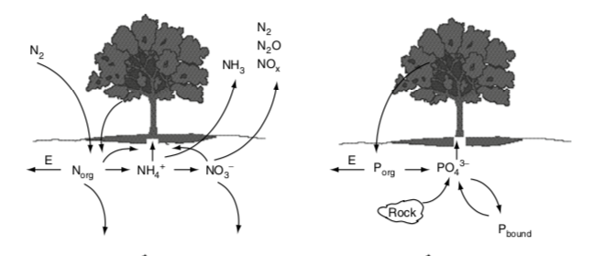

Slide 10
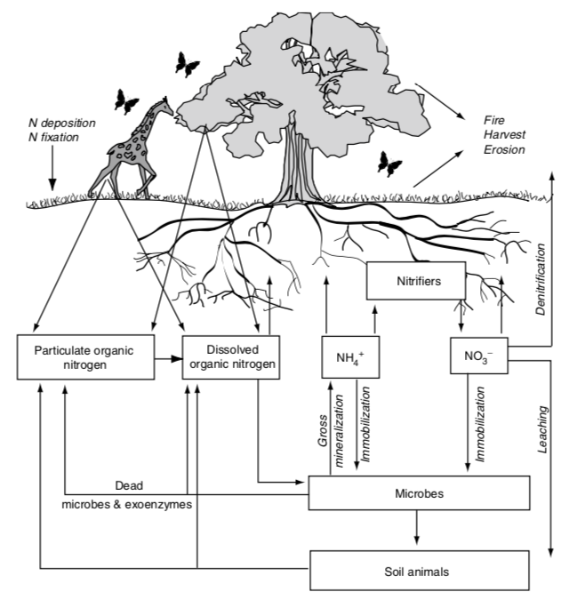
The terrestrial N cycle

Slide 11
The terrestrial N cycle
Nitrogen is constantly changing forms due to biological organisms

Slide 12
The terrestrial N cycle
Bacteria
Fungi
Nitrogen is constantly changing forms due to biological organisms (mostly microbes)
USDA

Slide 13
Important N forms
N₂
Nitrogen gas
Lots in the atmosphere
Cannot be taken up by plants or most microbes (just N fixers)
NO₃⁻
Nitrate
Highly mobile
Can be easily taken up by plants and most microbes
NH₄⁺
Ammonium
Mobile
Can be easily taken up by plants and most microbes
Dissolved organic N (DON)
Organic (contains C)
Produced by dead organisms
Cannot be taken up by plants
Can be broken down by microbes

Slide 16
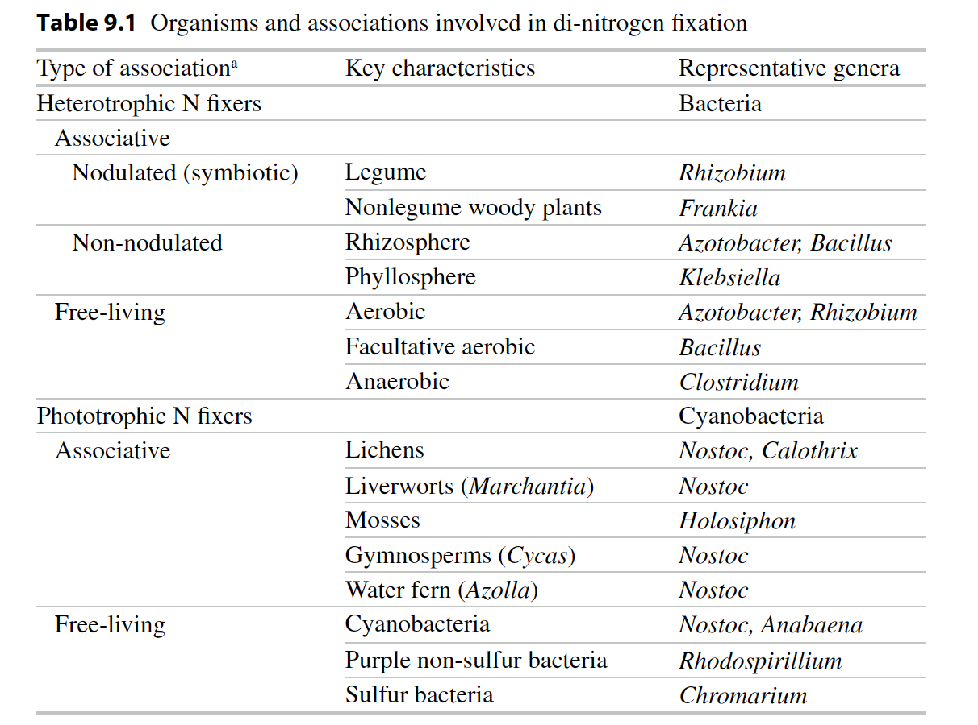
Biological N fixation: N₂ → NH₃

Slide 17
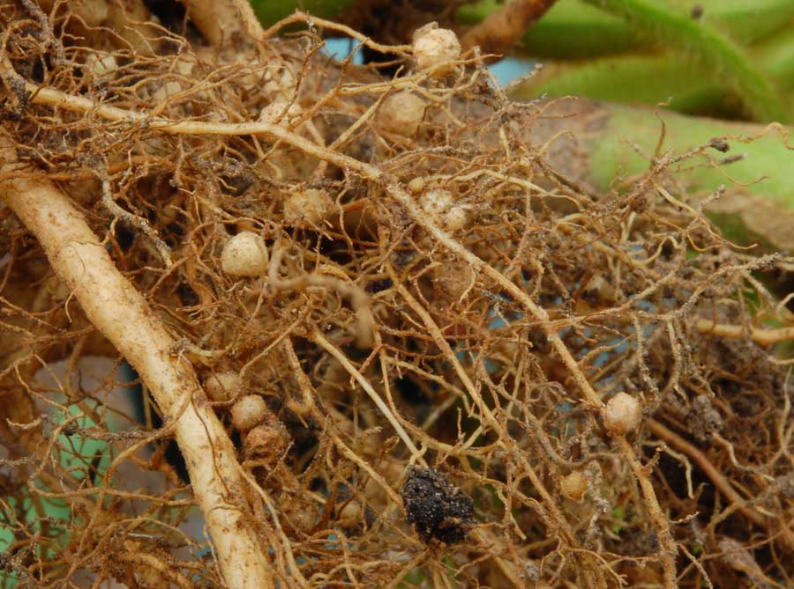
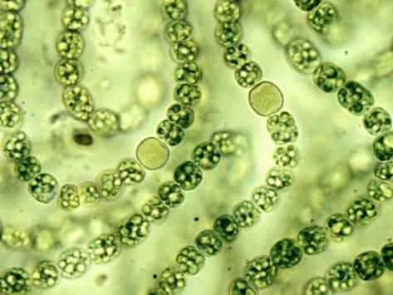
Nodules
Heterocysts
Soil Aggregates

Slide 18
Questions to ponder
Why wouldn’t all plants associate with N fixing bacteria?
Where would you expect to find plants that associate with N fixing bacteria?

Slide 19
Menge et al. (2019)

Slide 21
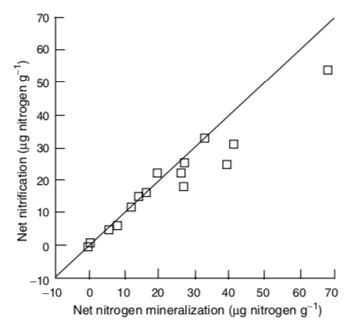
Nitrification: NH₃ → NO₂ → NO₃
Constantly happening in soil and determined by the amount of NH₃ produced by mineralization

Slide 22
Nitrification: NH₃ → NO₂ → NO₃
NH₃ amount explains spatial and temporal variability in nitrification

Slide 23
Nitrification: NH₃ → NO₂ → NO₃
Consequences
N gas production
N more mobile

Slide 25
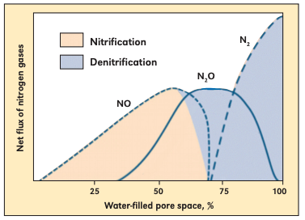
Denitrification: NO₃ → NO, N₂O → N₂
Occurs under high NO₃ and low O₂ conditions (e.g., high soil moisture)
Bouwman (1998)

Slide 27
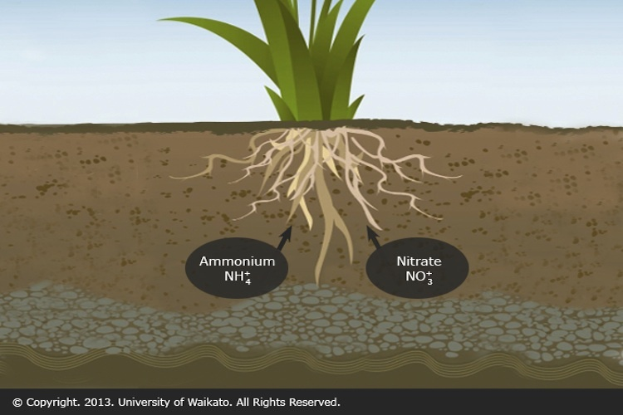
Assimilation: Inorganic N → Organic N
Via microbes or plants

Slide 29
Ammonification + Nitrification = Mineralization

Slide 30
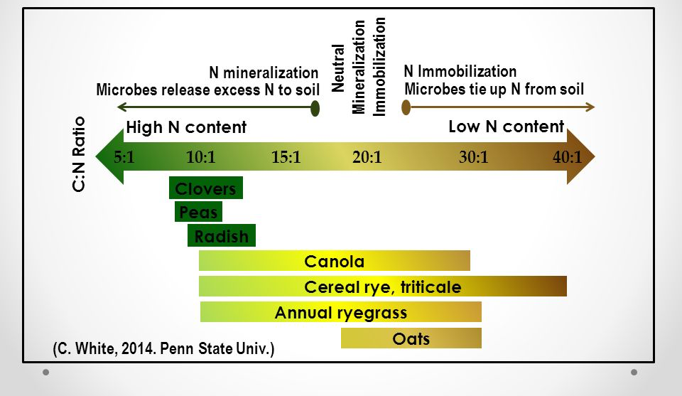
Assimilation: Inorganic N → Organic N Mineralization: Organic N → Inorganic N
Whether you have net mineralization or assimilation depends on the environment
High N = mineralization
Low N = assimilation

Slide 31
Gross Mineralization = Total amount of N released by mineralization (NH₄⁺ and NO₃⁻)
Net mineralization = Gross – immobilization – losses (NH₄⁺ and NO₃⁻)
Net mineralization = available for plant uptake

Slide 32
Linking above- and belowground processes

Slide 33
Linkages between above- and belowground processes
Litterfall-ANPP & Litter quality
Decomposition
Microbial/decomposer activity
DON

Slide 34
Linkages between above- and belowground processes
Rate Limiting Step to N cycling ?
Depolymerization
Litterfall-ANPP & Litter quality
Decomposition
Microbial/decomposer activity
DON

Slide 35
DON
Bacteria and fungi secrete extracellular enzymes to break
complex polymers down into water soluble units that can
pass through cell membranes
Proteases Proteins Amino acids
Ribonucleases Nucleic acids Nucleotides
Chitinases Chitins
Cellulase N polymers

Slide 36
High protease activity yields more amino acids
Kielland 2006

Slide 37
Fate of DON???

Slide 38
Fate of DON
Taken up by mycorrhizae

Slide 39
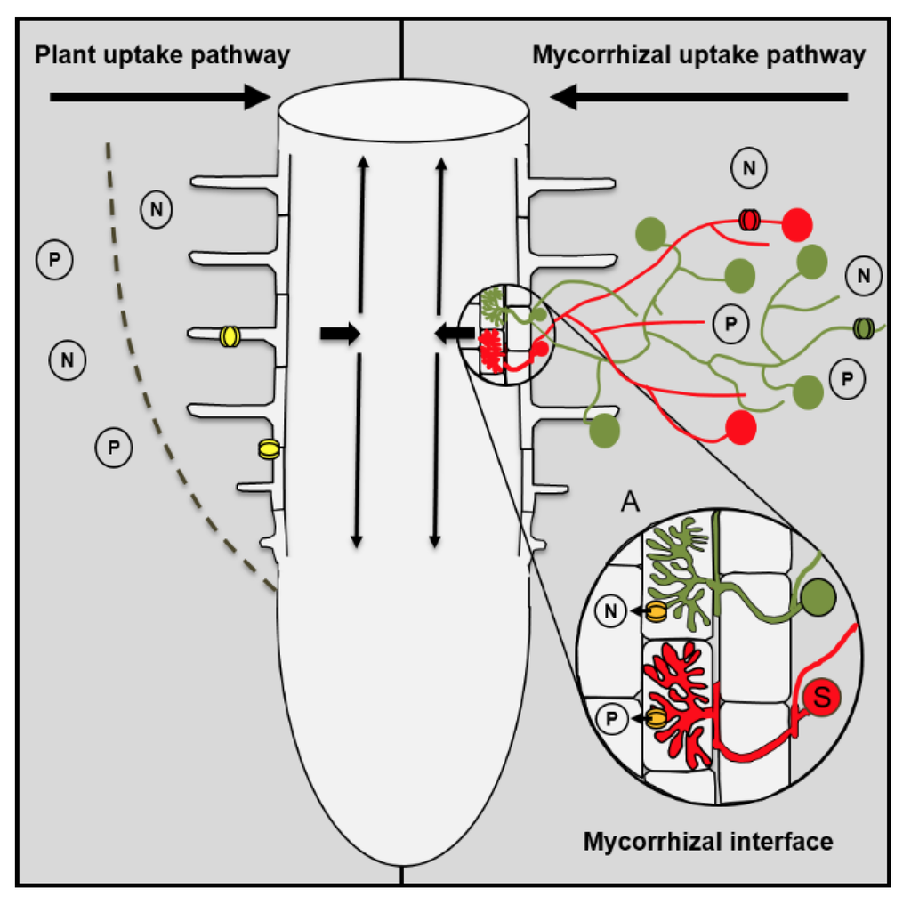
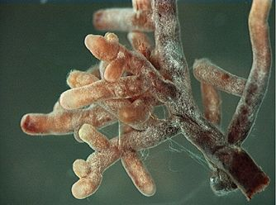
Linkages between above- and belowground processes
DON
Uptake by ECM & plants
Notes:
Taken up by plant (not too common)
Taken up by mycorrhiza
Leached to gw
Absorbed to soils
Taken up by microbes

Slide 40
Fate of DON
Taken up by mycorrhizae
Mineralized by microbes

Slide 41
Nitrogen Mineralization
•N Mineralization results from microbial break-down of DON
•Microbes release NH₄⁺ to soil solution as they use carbon
Organic-N
(R-NH₂) NH₄⁺
Mineralization
(ammonification)

Slide 42
Linkages between above- and belowground processes
CO₂
DON
NH₄⁺
Ammonification
Notes:
Taken up by plant (not too common)
Taken up by mycorrhiza
Leached to gw
Absorbed to soils
Taken up by microbes

Slide 43
Fate of DON
Taken up by mycorrhizae
Mineralized by microbes
Leached (not too common)

Slide 44
Fate of NH₄⁺???

Slide 45
Fate of NH₄⁺
Nitrified by microbes

Slide 46
Linkages between above- and belowground processes
Gross Mineralization= Total amount of N released by mineralization (NH₄⁺ and NO₃⁻)
Net mineralization= Gross – immobilization – losses (NH₄⁺ and NO₃⁻)
(available for plant uptake)
DON
NO₂⁻
NH₄⁺
NO₃⁻
Nitrification
Ammonification
Mineralization
Notes:
Taken up by plant (not too common)
Taken up by mycorrhiza
Leached to gw
Absorbed to soils
Taken up by microbes

Slide 47
Fate of NH₄⁺
Nitrified by microbes
Assimilated up by microbes (not too common)
Assimilated up by plants (not too common)
Leached (not too common)

Slide 48
Fate of NO₃⁻???
Notes:
)

Slide 49
Fate of NO₃
Assimilated by plants

Slide 50
Linkages between above- and belowground processes
Assimilation
DON
NO₂⁻
NH₄⁺
NO₃⁻
Nitrification
Ammonification
Mineralization
Notes:
Taken up by plant
Immobilized
Leached to gw (very mobile)
Absorbed to soils
Reduced by denitrifying microbes to N2, Nox, N20

Slide 51
Fate of NO₃
Assimilated by plants
Denitrified by microbes
Leached

Slide 52
Linkages between above- and belowground processes
Assimilation
N₂
DON
NO_{x}
N₂O
NO₂⁻
NH₄⁺
De-Nitrification
NO₃⁻
Nitrification
Ammonification
Leached to groundwater
Mineralization
Notes:
Taken up by plant
Immobilized
Leached to gw (very mobile)
Absorbed to soils
Reduced by denitrifying microbes to N2, Nox, N20

Slide 53
Speed of N cycling

Slide 54
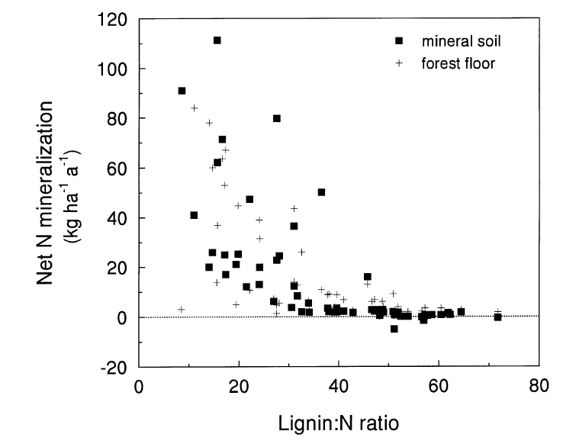
Litter quality increases N cycling
Scott & Binkley 1997

Slide 55
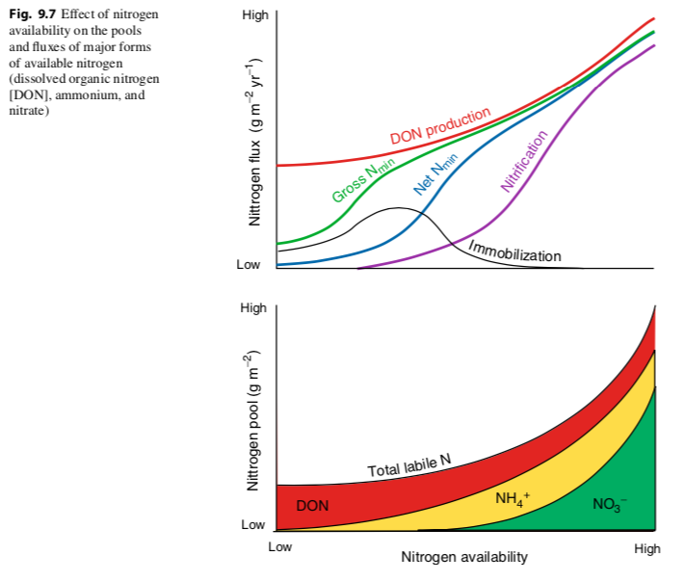

Slide 56
Temperature increases N cycling

Slide 57
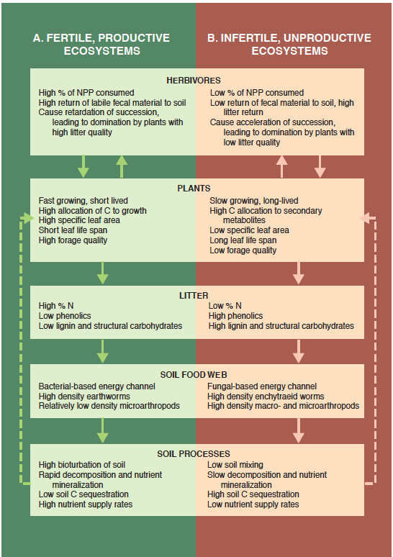
Fast Cycling Systems
Slow Cycling Systems

Slide 58
Why might organisms manipulate the speed of N cycling?

Slide 62
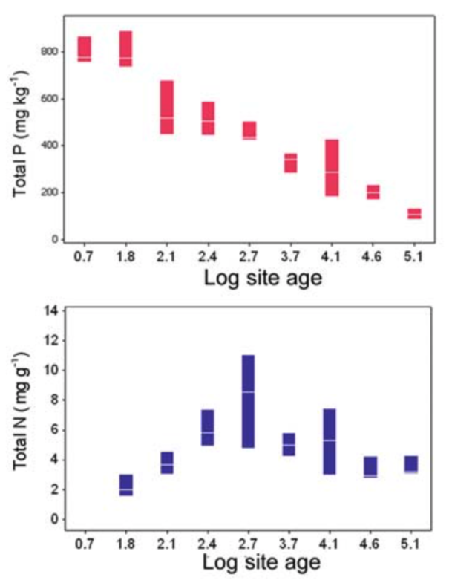
Most P enters systems through recycling

Slide 64
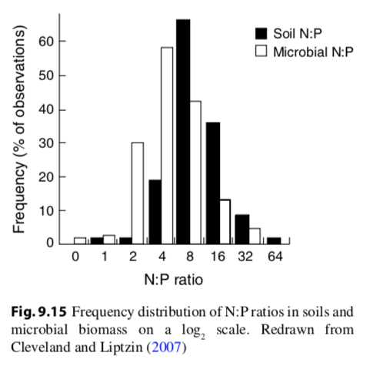
Microbes have a ton of P!
Microbial P = 20-30% total ecosystem P
Microbial N = 4% total ecosystem N
Microbial C = 2% total ecosystem C
Microbial N:P = 7:1
Plant N:P = 28:1

Slide 65
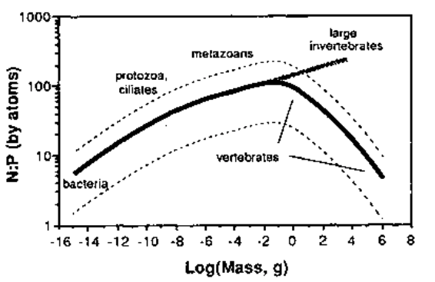
N:P tends to increase with organism size…

Slide 66
…but vertebrates are weird!

Slide 67
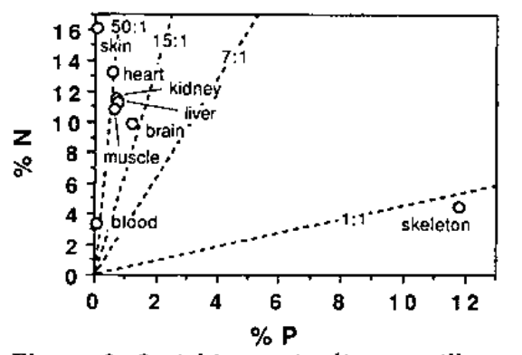

Slide 69
Mycorrhizae are very important for plant P uptake
Exchange P for C
Define the plant-soil P interface
Vessicular – arbuscular mycorrhizal fungi

Slide 70
Mycorrhizae are very important for plant P uptake
Arbuscule
(exchange site)
Vesicle
(storage)
Vessicular – arbuscular mycorrhizal fungi

Slide 72
Ectomycorrhizae get relatively more N than P
Arbuscular mycorrhizae get relatively more P than N

Slide 73
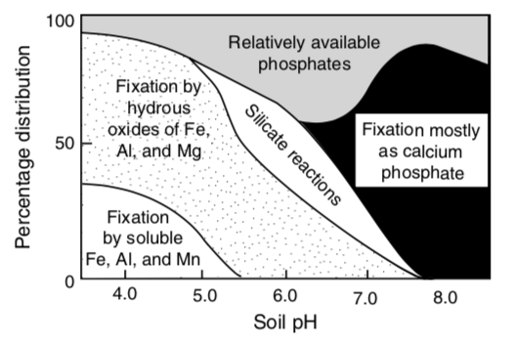
P binds to things, is more available at moderate pH

Slide 74
Agriculture

Slide 75
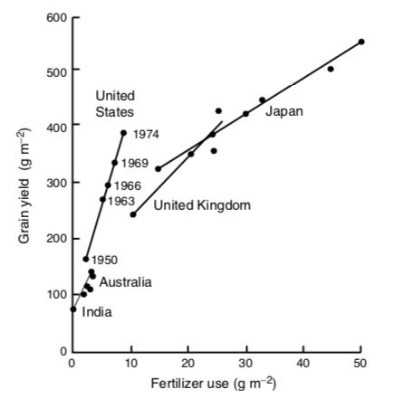

Slide 76
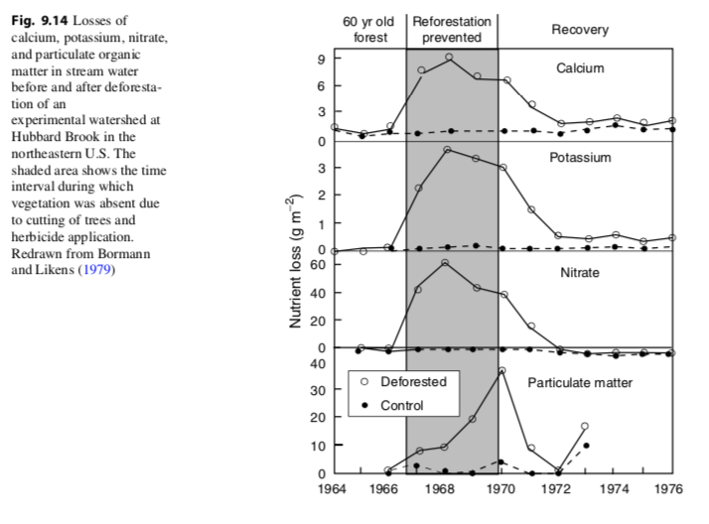

Slide 77
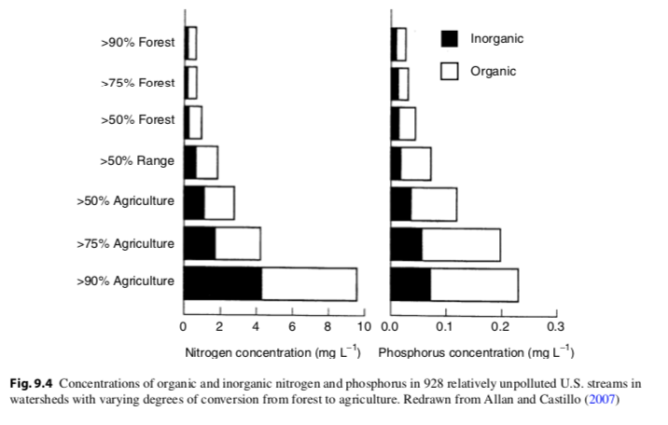

Slide 78
From agriculture and fossil fuel burning
NOAA

Slide 79
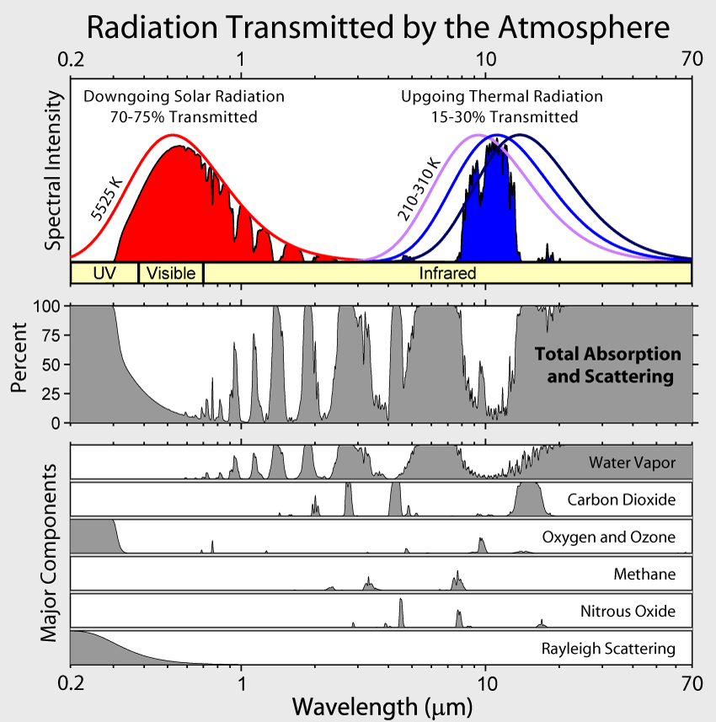

Slide 81
What might be the ecosystem impacts of fertilizer use?

Slide 82
How do we avoid these?

Slide 83
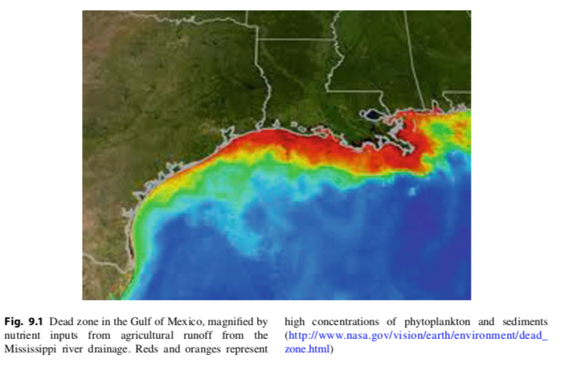

Slide 84
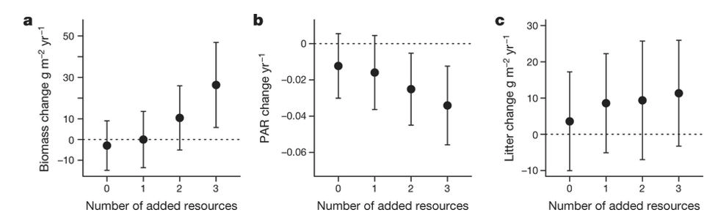
Harpole et al. (2016)

Slide 85
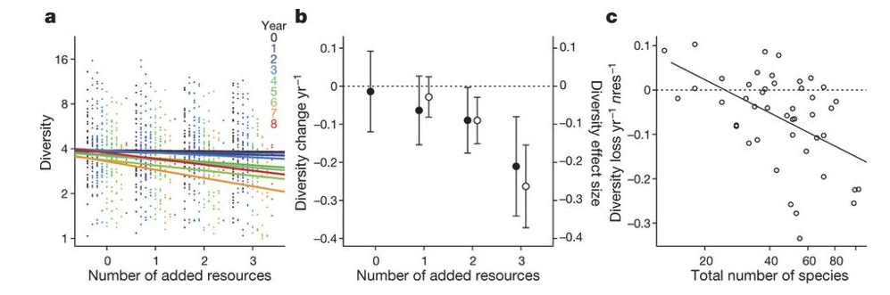
Harpole et al. (2016)

